Slide 1
CanCURVE

Slide 2



Slide 3

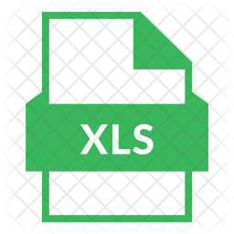
Required files (David)
DDF_RuleBook_r0.xlsm
Master file which contains most of the VB code and line items, etc.
DDFwork_MainTemplate_2023-09-06.xlsm
Copy and rename this for each new building type, price list (location), etc.
A_B-C_templateSheets.xls
Template sheet for each specific building, contains details from *.esx. From this file, 2 worksheets are required to be copied to DDFwork_MainTemplate_2023-09-06.xlsm
- DDFwrk_grp2
-A_B-C-DE_info

Slide 4
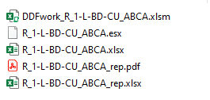
Sample Folder we shared with you:
DDFwork_MainTemplate_2023-09-06.xlsm
and A_B-C_templateSheets.xls combined
Not needed for this tool to work. (I will delete it)
PDF to Excel –CLEAN (containing only line items)
Source PDF which has all the information needed
PDF to Excel – containing Everything (line items and room sizes)

Slide 5
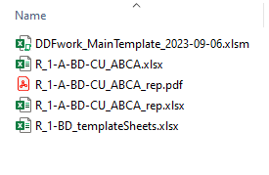
Clean Example Folder
Main Template – to be renamed
PDF to Excel –CLEAN (containing only line items)
Source PDF which has all the information needed
PDF to Excel – containing Everything (line items and room sizes)
Template sheet Need to copy 2 worksheets to the *.xlsm
1. DDFwrk_grp2
2. A_B-C-DE_info

Slide 6
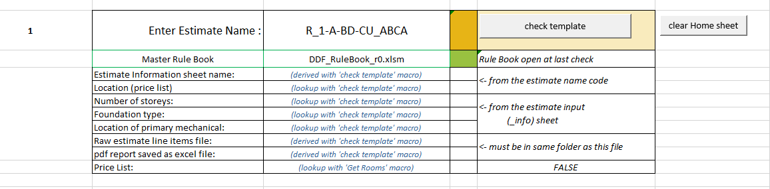
Functions: Check template:
User Enter Name
This name should match that of the PDF

Slide 7
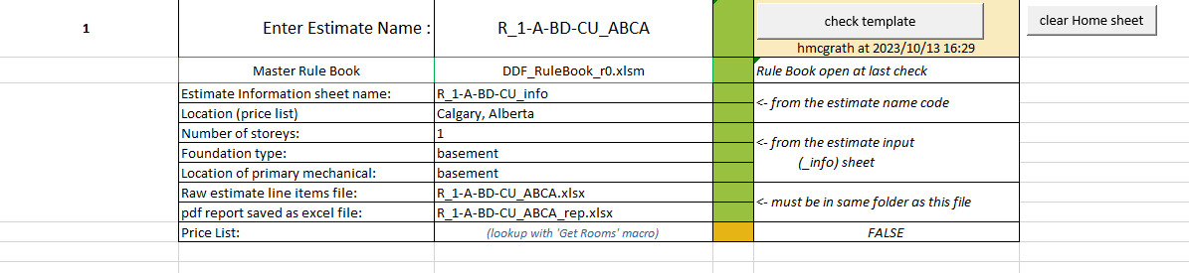
Functions: Check template:
Check template:
Populates column D, rows: 8 thru 15

Slide 8
Functions: GetLines
This reads in data from the XLS, in this case: R_1-A-BD-CU_ABCA
It populates tab: ‘LineItems’

Slide 9
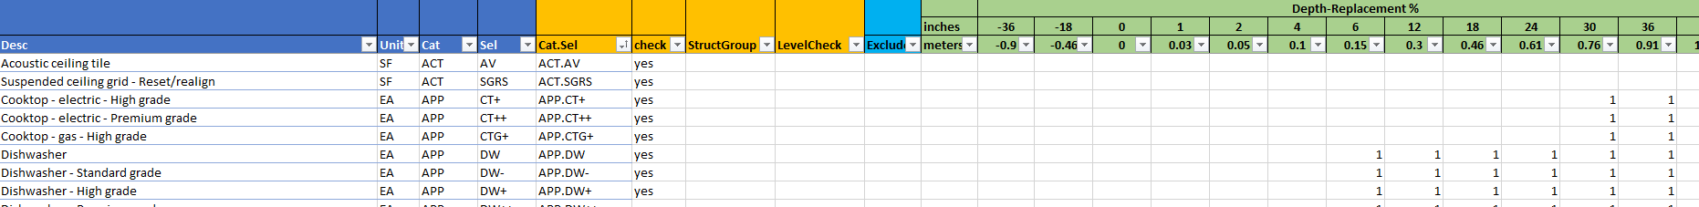
Function: Check Rules
This performs a cross-reference check between the “LineItems” in this workbook and the “LineRules” in the DDF_RuleBook_r0.xlsm
This is important because the DDF_RuleBook contains details on damage per water level for each item:
DDF_RuleBook_r0.xlsm, tab: LineRules

Slide 10
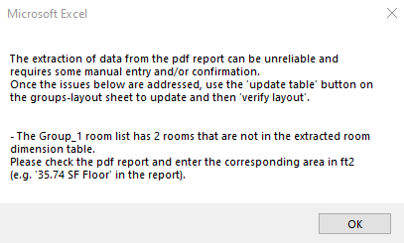
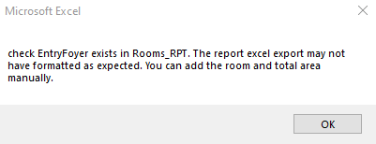
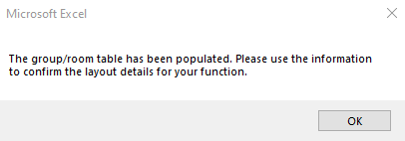
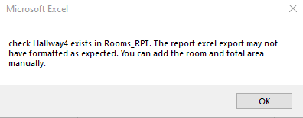
Functions:

Slide 11
